Slide 1
Total Sales
1924.34 K
Total Profit
224.08 K
Total Unique Customer
1952
Total Quantity of Order
25 K

Slide 2
Region-Wise Data Analysis
Region | Sales | Profit | Quantity of Orders | Customer
Central | 448.28 K | 75.37 K | 6575 | 566
South | 357.11 K | -14.42 K | 5045 | 474
East | 592.17 K | 85.29 K | 7031 | 442
West | 526.78 K | 75.84 K | 6617 | 470

Slide 3
Customer Segment
Consumer
Sales – 401.78 K
Quantity – 5238
Profit – 49.89 K
Corporate
Sales – 657.78 K
Quantity – 8431
Profit – 54.44 K
Small Business
Sales – 400.29 K
Quantity – 5328
Profit – 65.30 K
Home Office
Sales – 464.48 K
Quantity – 6271
Profit – 54.43 K

Slide 4
Category of Product Analysis
Furniture | Sales | Quantity of Order | Profit | Customers
Chairs and Chair mats | 261.07 K | 1227 | 48.70 K | 92
Tables | 193.76 K | 944 | -7.24 K | 80
Bookcases | 107.8 K | 536 | -930.44 | 43
Office Furniture | 98.07 K | 2356 | 18.72 K | 185
Technology | Sales | Quantity of Order | Profit | Customers
Office Machines | 318.17 K | 898 | 8.82 K | 95
Telephones and Communication | 198.76 K | 2358 | 40.79 K | 194
Copiers and Fax | 99.07 K | 181 | 23.99 K | 18
Computer Peripherals | 96.26 K | 2481 | 1.70 K | 174
Office Supplies | Sales | Quantity of Order | Profit | Customers
Binder and Binder Accessories | 185.93 K | 2554 | 59.30 K | 200
Storage and Organization | 177.42 K | 1904 | 7.12 K | 130
Appliances | 82.20 K | 1187 | 12.59 K | 100
Paper | 55.81 K | 3481 | 7.77 K | 284
Pens and Art Supplies | 26.07 K | 2744 | -257.63 | 161
Envelopes | 10.48 K | 590 | -1.19 K | 55
Scissors, Rulers and Trimmers | 6.75 K | 423 | -1.29 K | 36
Labels | 4.91 K | 903 | 7.03 K | 71
Rubber Bands | 1.79 K | 501 | -1.54 K | 34

Slide 5
Ship Mode
Delivery Truck
Sales - 789.24 K
Quantity of Order - 58.76 K
Express Air
Sales - 145.05 K
Quantity of Order - 15.57 K
Regular Air
Sales - 990.05 K
Quantity of Order - 19 K

Slide 6
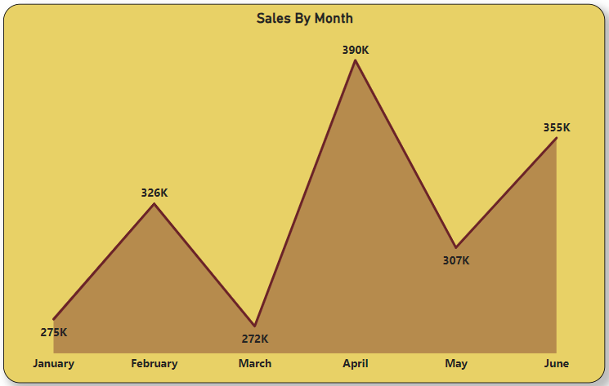
Monthly Sales

Slide 7
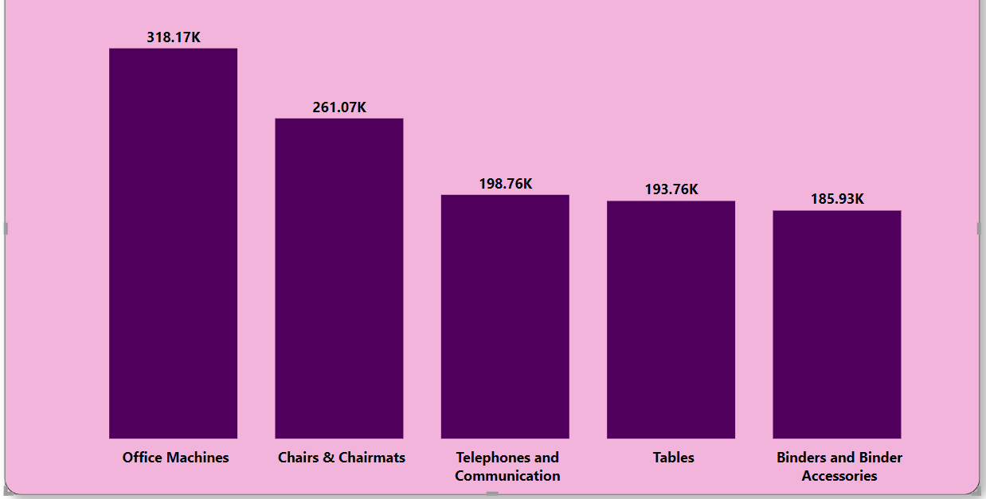
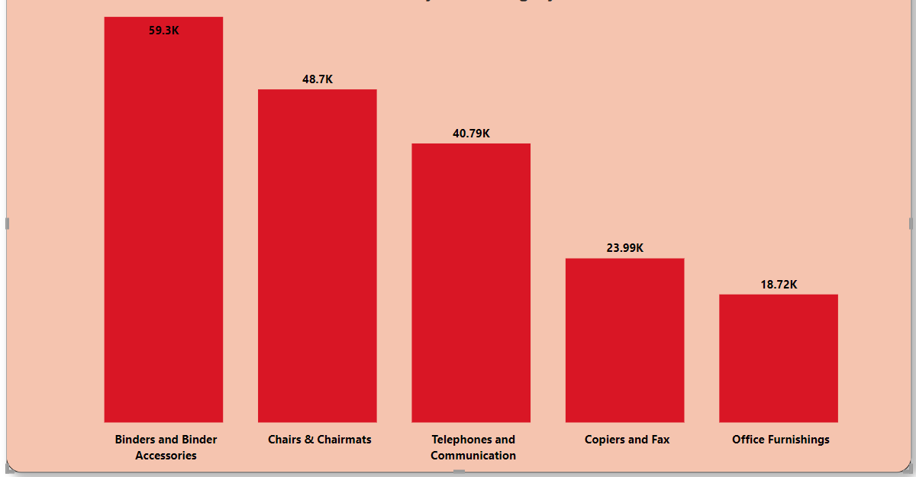
Top 5 Sales By Sub-Category
Top 5 Profit By Sub-Category

Slide 8
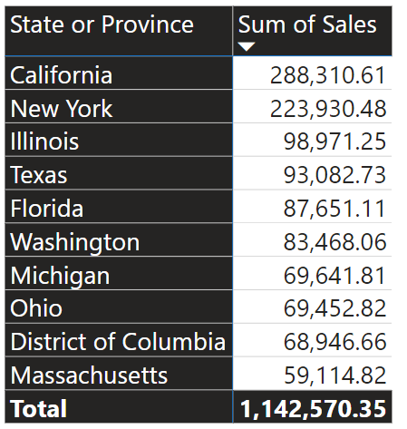
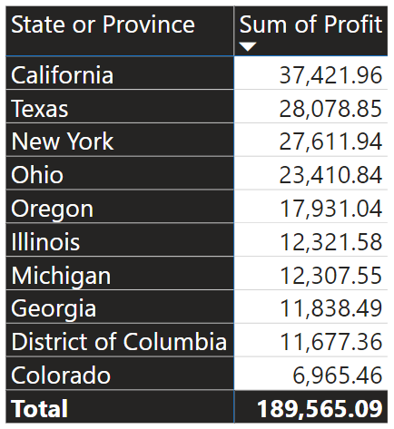
Top 10 Sales By State or Province
Top 10 Profit By State or Province

